Slide 1
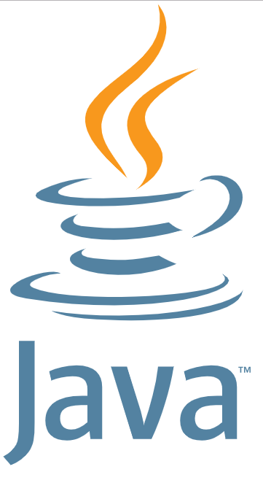
Java introduction
Petro Kostur
petro.kostur@gmail.com
570 270 798

Slide 2
Java - What is Java?
Java is a programming language
Java also means a platform
Java programming language:
https://www.oracle.com/technetwork/java/intro-141325.html
Simple, Object Oriented, and Familiar
Robust and Secure
Architecture Neutral and Portable
High Performance
Interpreted, Threaded, and Dynamic

Slide 3
Java platform
2 things:
JVM (Java Virtual Machine)
Java API (Java Application Programming Interface) - JRE/JDK
https://techpursue.com/jvm-and-jre/

Slide 4
What is JVM
JVM is java virtual machine
JVM is an interpreter which executes bytecode
Each byte Statement executed line by line by Jvm.
JVM uses JRE to execute Byte code.
Your Java code ---compiles to---> Bytecode ---executes by---> JVM
Operating System -> JVM -> Java API -> Your Java program

Slide 5
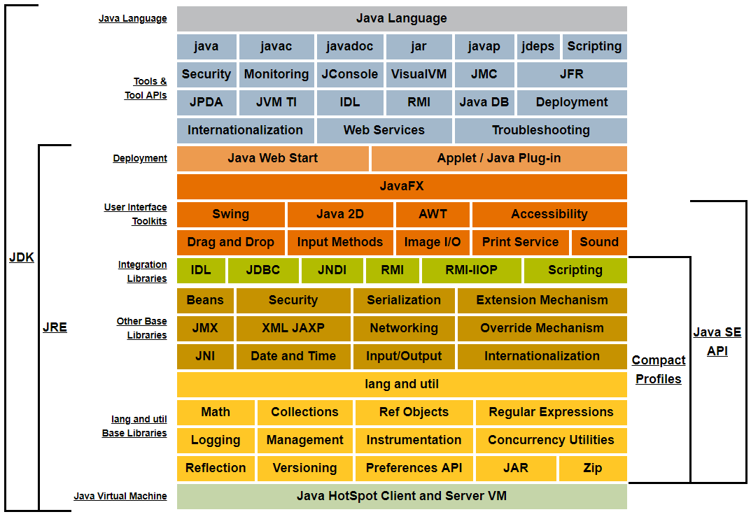
Java API structure (Java 8)
https://docs.oracle.com/javase/8/docs/
https://docs.oracle.com/javase/8/docs/api/

Slide 6
Java versions
Java 1.0 (1995)
Java 2.0 (1998) - Swing, collections, Java 2D, JIT-compiler
Java 5.0 (2004) - enums, annotations, generics, for-each loop
Java 6 (2006) - scripting languages support
Java 7 (2011) - Project Coin, NIO2, InvokeDynamic, Fork/Join Framework
Java 8 (2014) - lambda expressions, stream API, default methods, Java Time API, Optional
Java 9 (2017) - project Jigsaw, HTTP 2.0 full support
Java 10 (2018)
Java 11 (2018) - some breaking changes (!)

Slide 7
Java Editions
EE
SE
ME

Slide 8
Install JDK
https://www.oracle.com/technetwork/java/javase/downloads/jdk8-downloads-2133151.html

Slide 9
Hello World
// upper/lower case matters
// main is not the same as Main, string is not the same as String
//save this code to file named MyHelloWorld.java
public class MyHelloWorld {
public static void main(String[] args) {
System.out.println("hello world");
}
}

Slide 10
Compile and run
Compile
javac MyHelloWorld.java
Run
java MyHelloWorld

Slide 11
Books for beginners
Head First Java, by Bert Bates, Kathy Sierra (OReilly)
Effective Java, 3rd Edition, by Joshua Bloch (Addison-Wesley)
Java By Comparison, by Jörg Lenhard, Linus Dietz, Simon Harrer
Java Programming 24-Hour Trainer, 2nd Edition, by Yakov Fain

